Slide 1
XPath

Slide 2
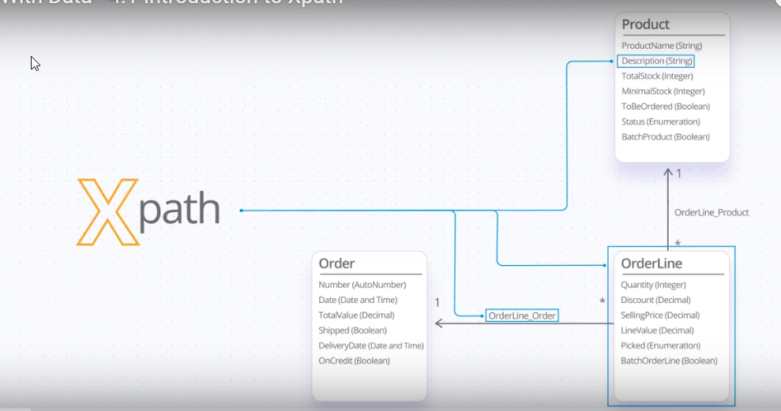
XPath is a database agnostic query language used to navigate the database model

Slide 3
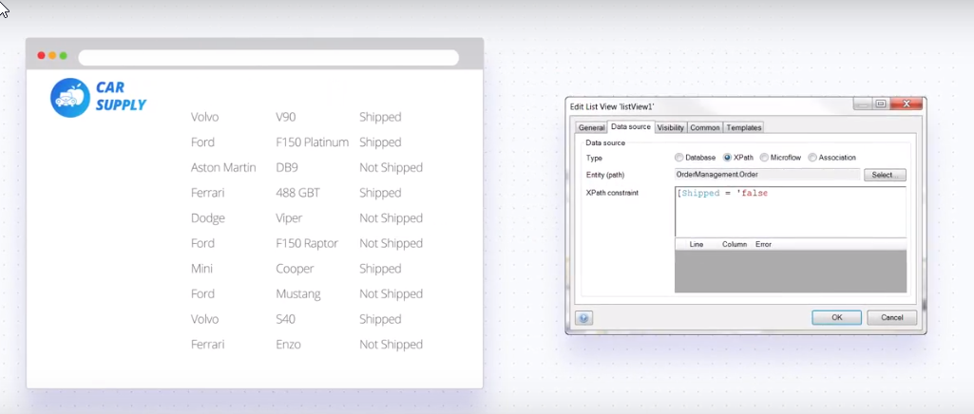
It can be used to constrain data is shown in a list…

Slide 4
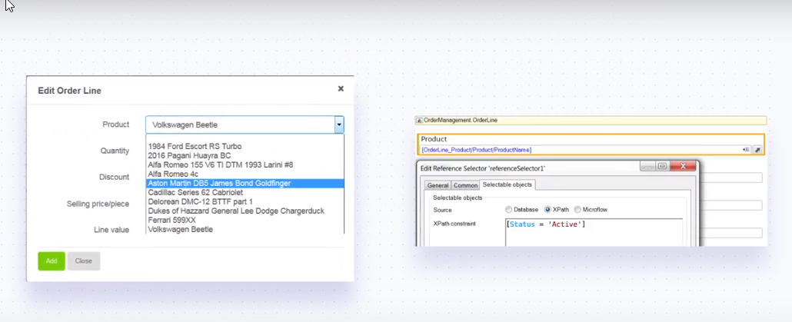
…constrain what data the user can select…

Slide 5
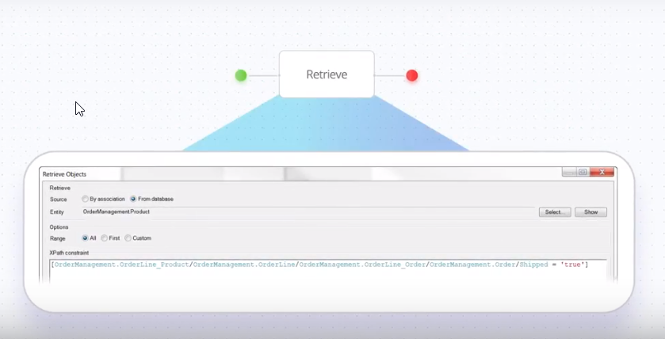
…or constrain data retrieved from the database.

Slide 6
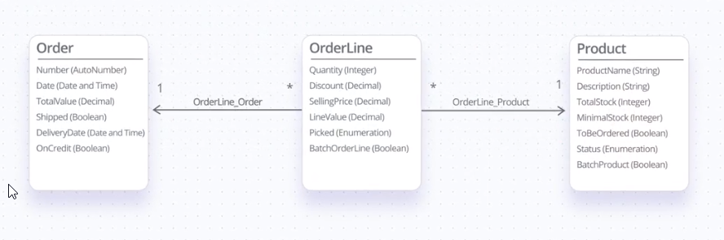
As an example, assume we have three entities as shown

Slide 7
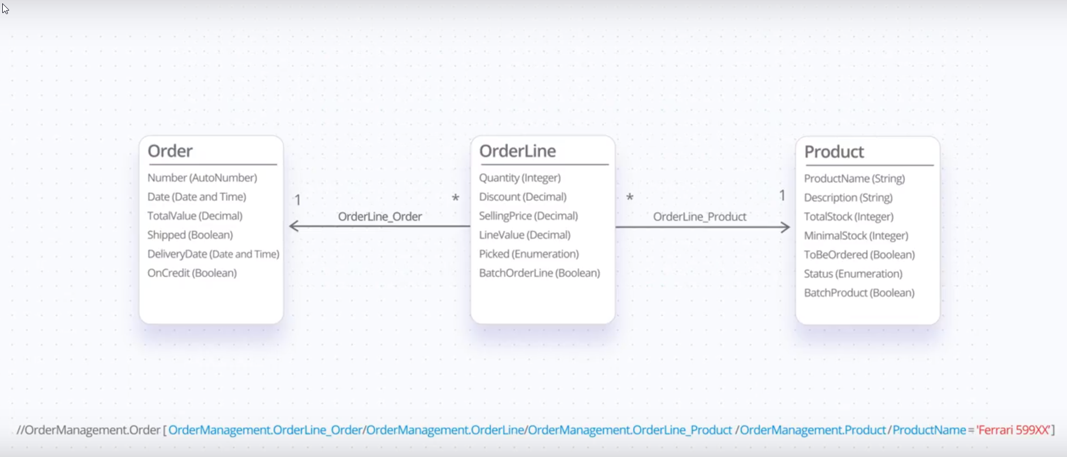
The constraint above retrieves the Orders which contain the product named Ferrari 599XX. The constraint navigates from Order to the Product.

Slide 8
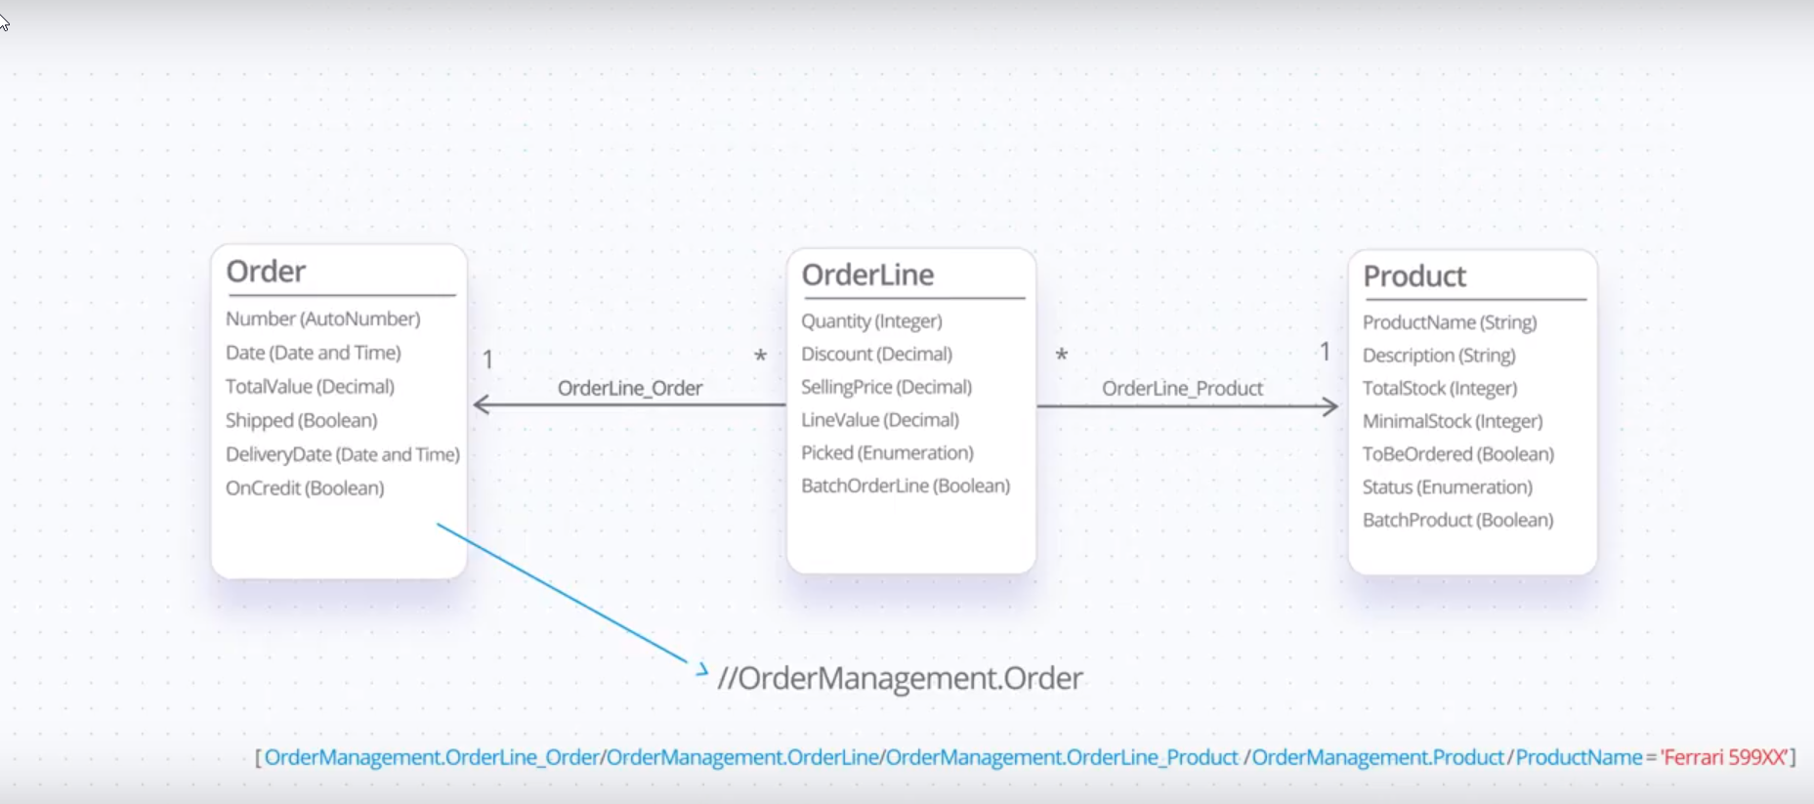
The first part is added by Mendix and represents the starting entity. You won't have to add this. Mendix determines based on the context. OrderManagement is the name of the module in which the domain model results and Order is the entity in the domain model.

Slide 9
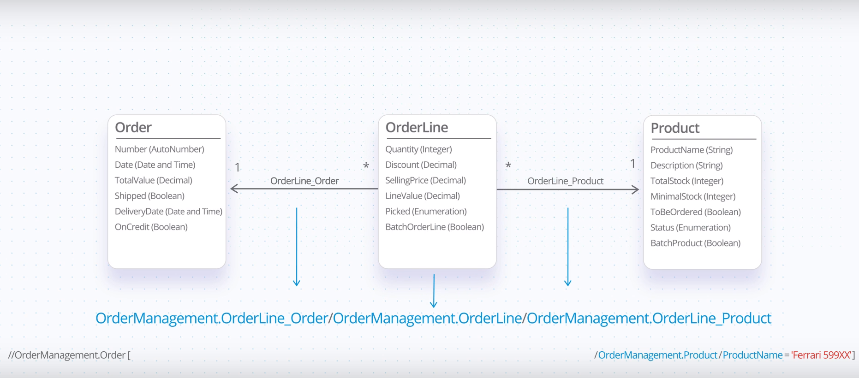
This part represents the path from Order to Product.

Slide 10
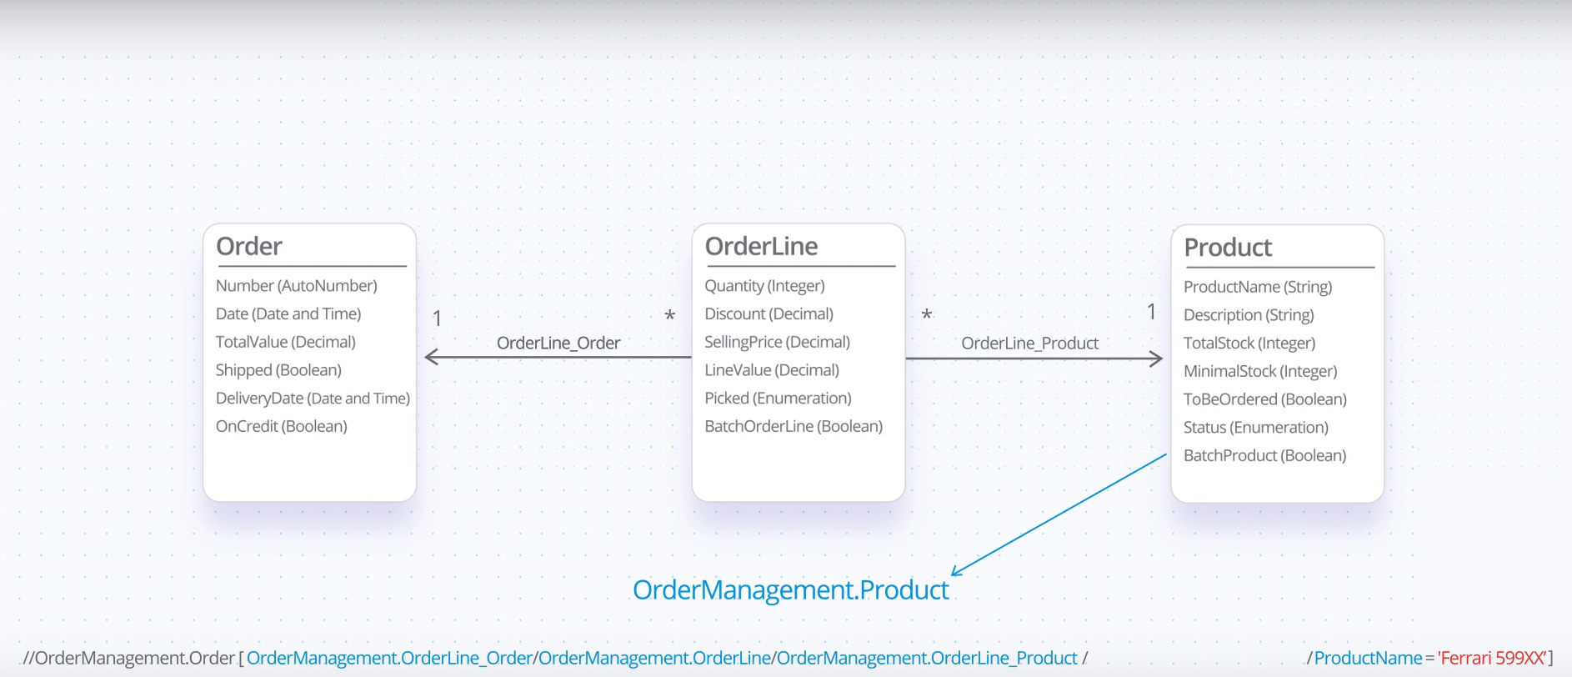
This is the destination entity

Slide 11
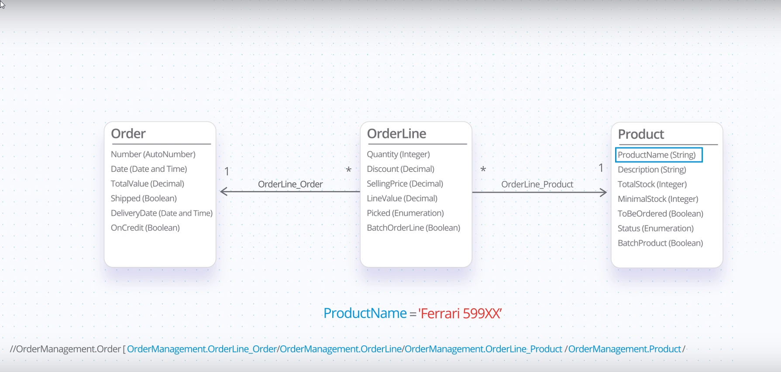
And this is the destination attribute and value

Slide 12
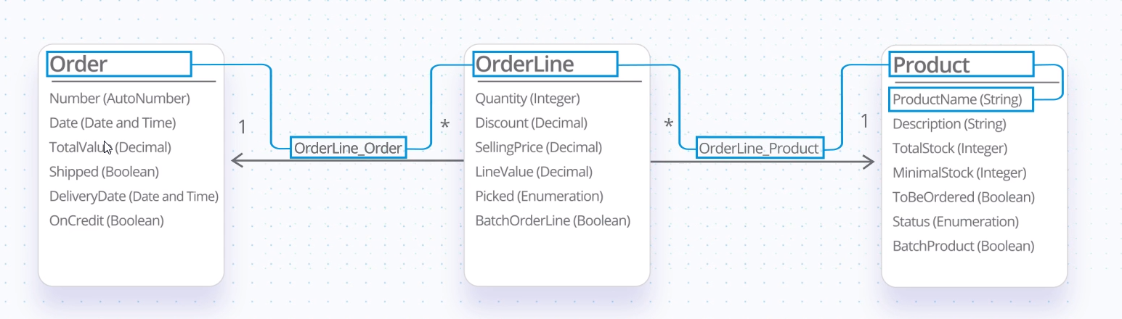
So the constraint navigates this path

Slide 13
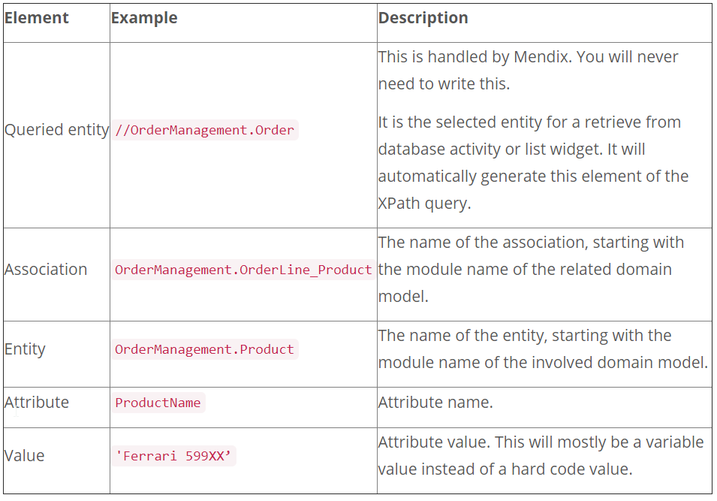
XPath Syntax

Slide 14
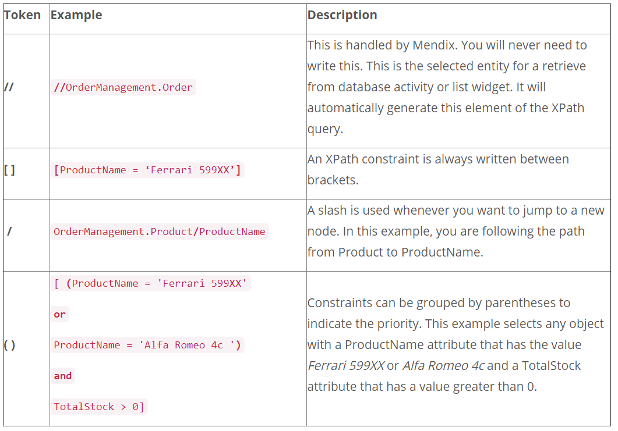
XPath Tokens

Slide 15
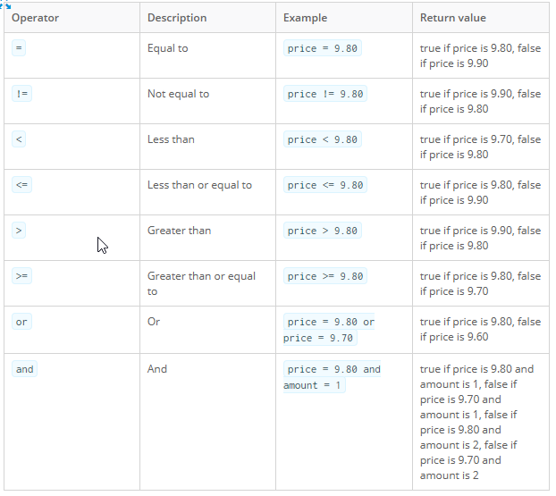
XPath Operators

Slide 16
XPath Functions
https://docs.mendix.com/refguide/xpath-constraint-functions
XPath Keywords and System Variables
https://docs.mendix.com/refguide/xpath-keywords-and-system-variables
XPath Exists
https://docs.mendix.com/refguide/xpath-expressions

Slide 17
And operator
[OrderManagement.SupplierProductDetail_Product = $Product] [OrderManagement.SupplierProductDetail_Supplier/OrderManagement.Supplier/Active]
Is equivalent to:
[OrderManagement.SupplierProductDetail_Product = $Product]
and
[OrderManagement.SupplierProductDetail_Supplier/OrderManagement.Supplier/Active]
Or operator
[OrderManagement.SupplierProductDetail_Product/OrderManagement.Product/ToBeOrdered or OrderManagement.SupplierProductDetail_Product/OrderManagement.Product/TotalStock <= OrderManagement.SupplierProductDetail_Product/OrderManagement.Product/MinimalStock]

Slide 18
Constructing XPath Constraints
Identify the entity that you are retrieving in the domain model.
From that entity, identify the path to the attributes and/or associations you want to constrain on.
Construct the XPath expression using the building blocks above.

Slide 19
References
https://gettingstarted.mendixcloud.com/link/module/22/lecture/122

